Slide 1

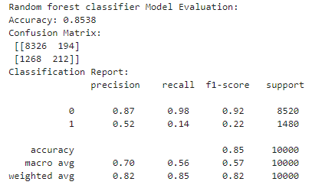
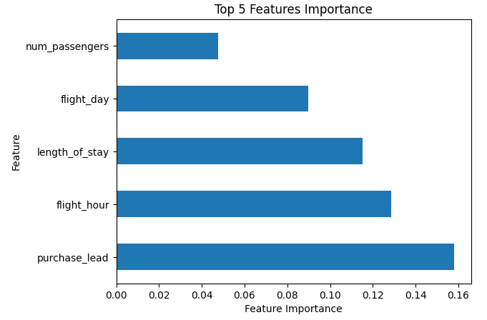
Analysis & Result
Overall, the model shows high accuracy of 85% in predicting instances of class 0 (booking not completed), but it struggles with instances of class 1 (booking completed), as indicated by the low precision, recall, and F1-score for class 1.
Analysis reveal, it's not directly predicting whether customers are buying holidays. Instead, it predicts whether the booking process is completed or not based on the given features. However, it's possible to infer whether a customer is buying holidays indirectly from the prediction of booking completion. If the model predicts that the booking process is completed, it suggests that there's a higher likelihood that the customer is indeed buying holidays.
To well predict customers buying holidays more accurately, additional features required that directly reflects customers' travel behavior and intentions may be necessary. This could include variables such as actual travel dates, flight check-ins, or post-travel feedback, browsing history on travel websites, income levels, package tours, booking destination etc. Integrating such data could provide a more accurate basis for predicting customers' holiday purchases and travel intentions.

